Slide 1

Jibu market ASsessment
By: Cole Novara, Dominick Kubica,
Dylan Gordon, and Tabitha Tomori

Slide 2
01
Company overview
02
Discussion of Data
03
EDA
TABLE OF CONTENTS
04
Analysis
05
Social Media/Market Analysis
06
Recommendations and COnclusions
Company data, situation, and analysis objective
Considerations
Examples of findings
Analysis conducted with charts and figures
Relevant information
What Jibu should do moving forward
Notes:
Presentation (Please upload slides as PowerPoint or PDF):
Each team will present on the project
(Should be no more than 15 minutes). The presentation should cover the following sections:
1.An overview of company (data), situation, and objective of analysis
2. What did you learn from exploratory data analysis?
3. An overview of analysis conducted
4. What was learned from the analysis? (Demonstrate with charts and figures)
5. What was learned from review/analysis of social media data (if applicable)?
6. Conclusions and Recommendations

Slide 3

Company Overview
Jibu Introduction
“Jibu is a for-profit social enterprise that empowers local entrepreneurs in emerging markets to provide essential goods and services like clean water, LPG cooking gas, and fortified porridge to their communities.”
Hybrid model- franchises generate income and drive social impact.
Equips entrepreneurs with capital, training, and support– aiming to create lasting solutions for improving health and well-being in underserved areas.

Slide 4
Company Overview
Company Situation
“We would like to understand how we can understand our customer segments better.”
1. Customer segmentation: Analyze customer data to segment the target audience based on demographics, geography, behavior, and needs.
2. Customer Lifetime Value: Calculate the Customer Lifetime Value of Jibu's customers to understand their long-term value to the business.
Market research and competitive analyses: Conduct market research and competitor analysis to identify opportunities, threats, and market trends.

Slide 5

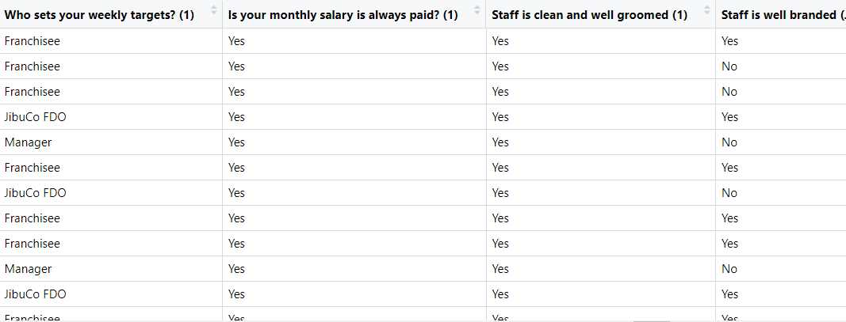
Example of Raw data recorded by jibu
Discussion Of Data
Not pertinent to Customer Values or Lifetime (Non-Numeric)

Slide 6
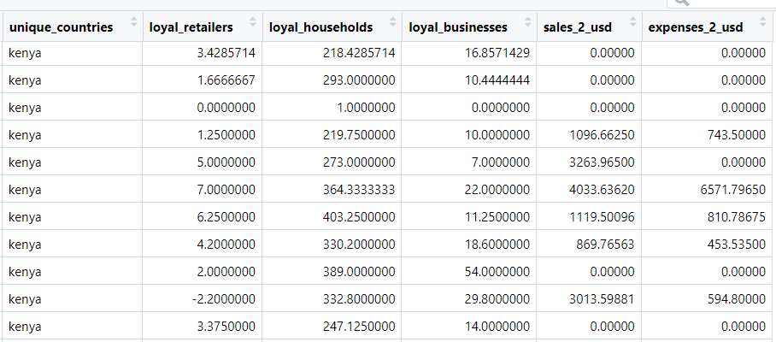
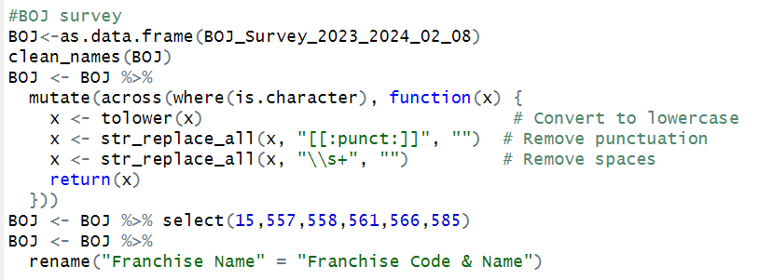
Discussion Of Data
Data Cleaning

Slide 7
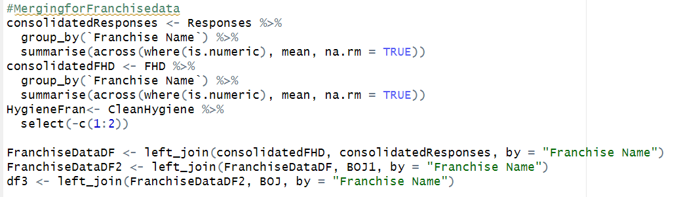
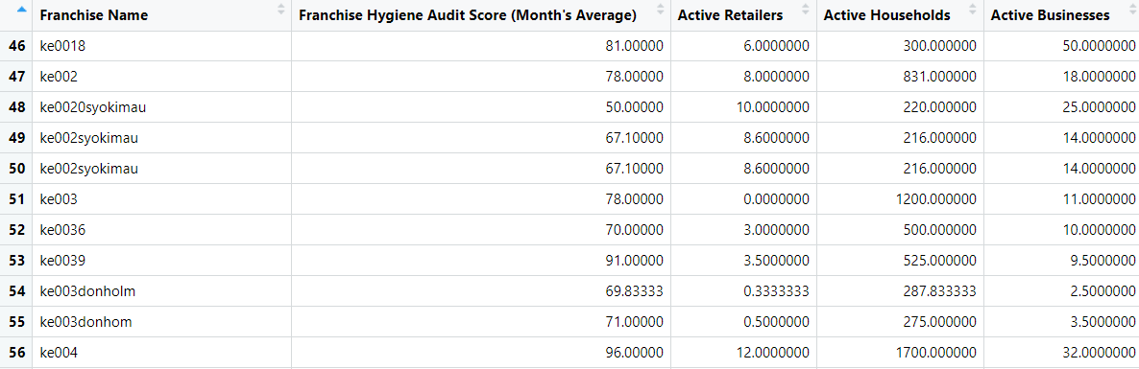
merging
Discussion Of Data

Slide 8
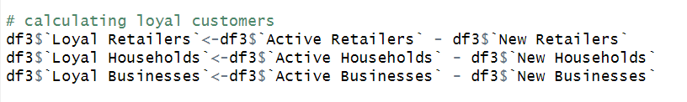
Discussion Of Data
Creating Loyalty Metric
Active Customers = Loyal Customers + New Customers
Loyal Customers = Active Customers - New Customers
New Customers - First time Purchaser

Slide 9
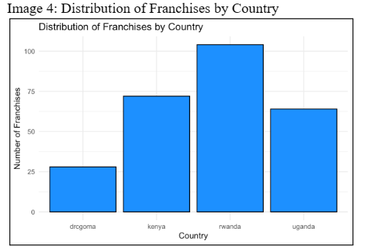
EDA
Distribution of Franchises BY Country

Slide 10
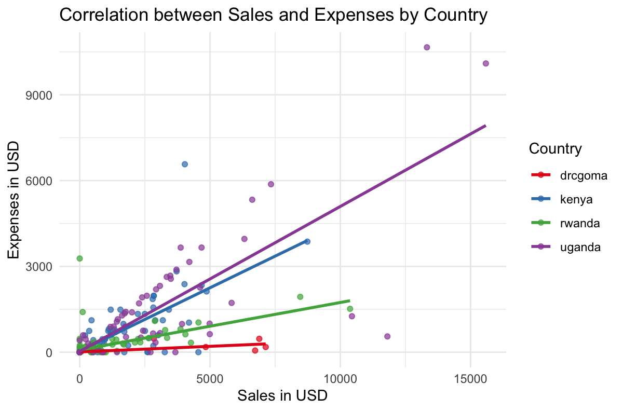
EDA
Correlation between Sales and Expenses by Country

Slide 11
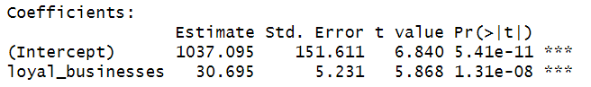
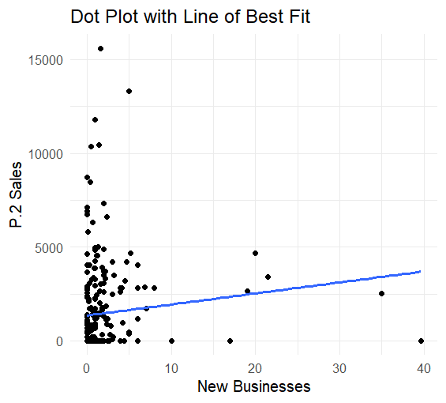
Analysis
Linear Regression
Coefficients show impact each loyal customer has on Sales in USD

Slide 12
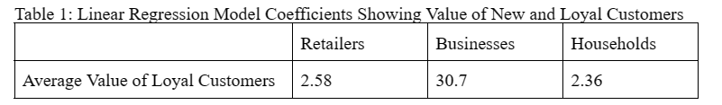
Analysis
Linear Regression Table
Summary of all the coefficients per category

Slide 13
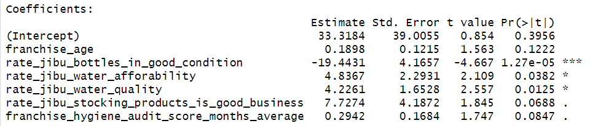
Step regression - Retail
Analysis
Quality of bottles does not support increase in loyal customers
Could be older businesses with older bottles have more loyal customers, or customers don’t care about bottle quality
Water affordability and Quality impacts number of loyal customers

Slide 14
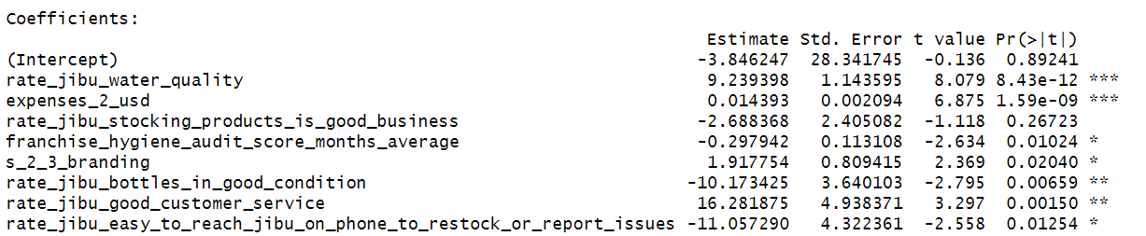
Step regression - Businesses
Analysis
Increase in Water Quality and Affordability leads to more Loyal Customers
Customer Service increases Loyal Customers
BUT accessibility via phone not as important

Slide 15
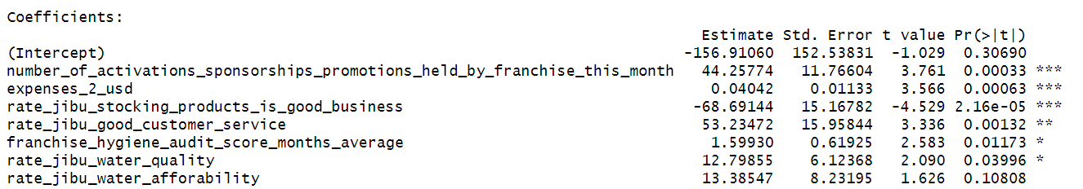
Step regression - Households
Analysis
Good Customer Service increases number of loyal customers
Water quality and affordability is important as well
Sponsorships and Promotions: Uniquely important to Households being loyal customers

Slide 16
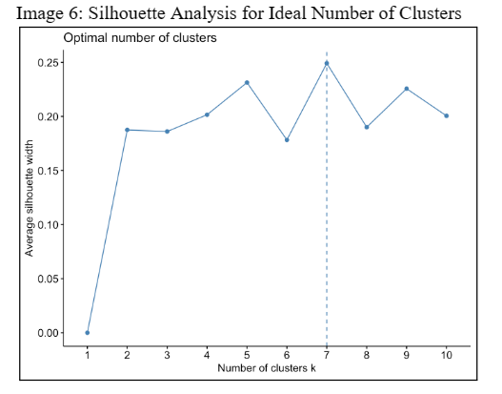
Clustering- Optimal Number of Clusters
Analysis
Performed silhouette analysis to find optimal number of clusters for k-means clustering
Optimal number of clusters found to be seven

Slide 17
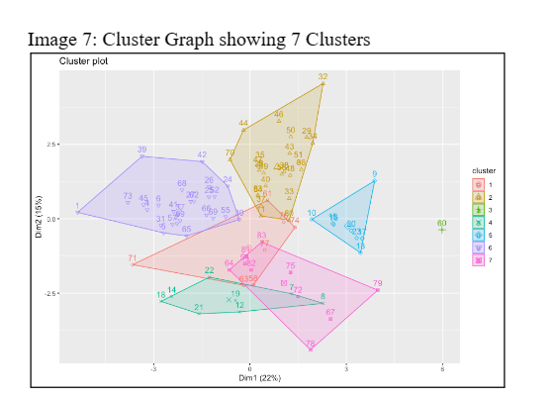
Analysis
Cluster PLot
Created cluster plot to visualize seven clusters more clearly
Cluster 3 modeled as an outlier; clusters had overlapping qualities

Slide 18
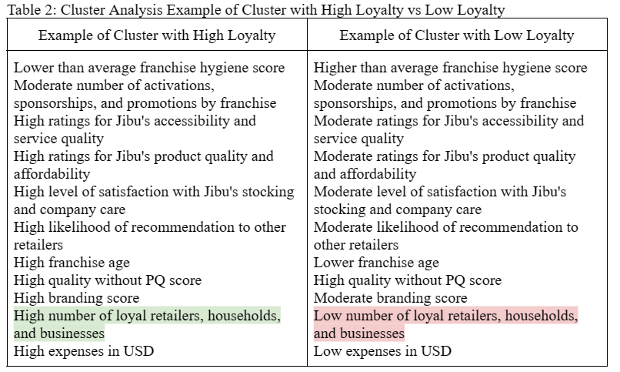
Analysis
CluSter Profiles
Differences in franchise hygiene score, product quality, satisfaction, and franchise age suggest that older franchises have more loyal customers.

Slide 19
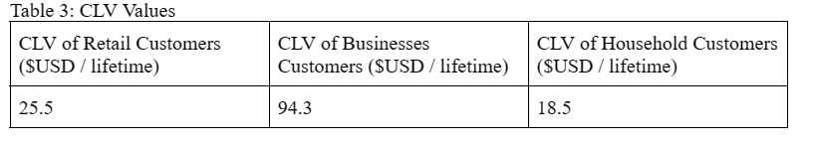
Analysis
Customer Lifetime Value (CLV)
Customer Lifetime Value (CLV)= Monthly Customer Value x Customer Lifetime (Months)
Monthly Customer Value = Linear regression Coefficients for (Sales~# of Loyal Customers)
Customer Lifetime (Months) = 1/Churn Rate
Churn Rate = (Churned Customers/total number of customers) x 100
Churned 1 = loyal 1 + New 1 + New 2 - Active 2 (Suffix 2 is current month, Suffix 1 is previous)

Slide 20
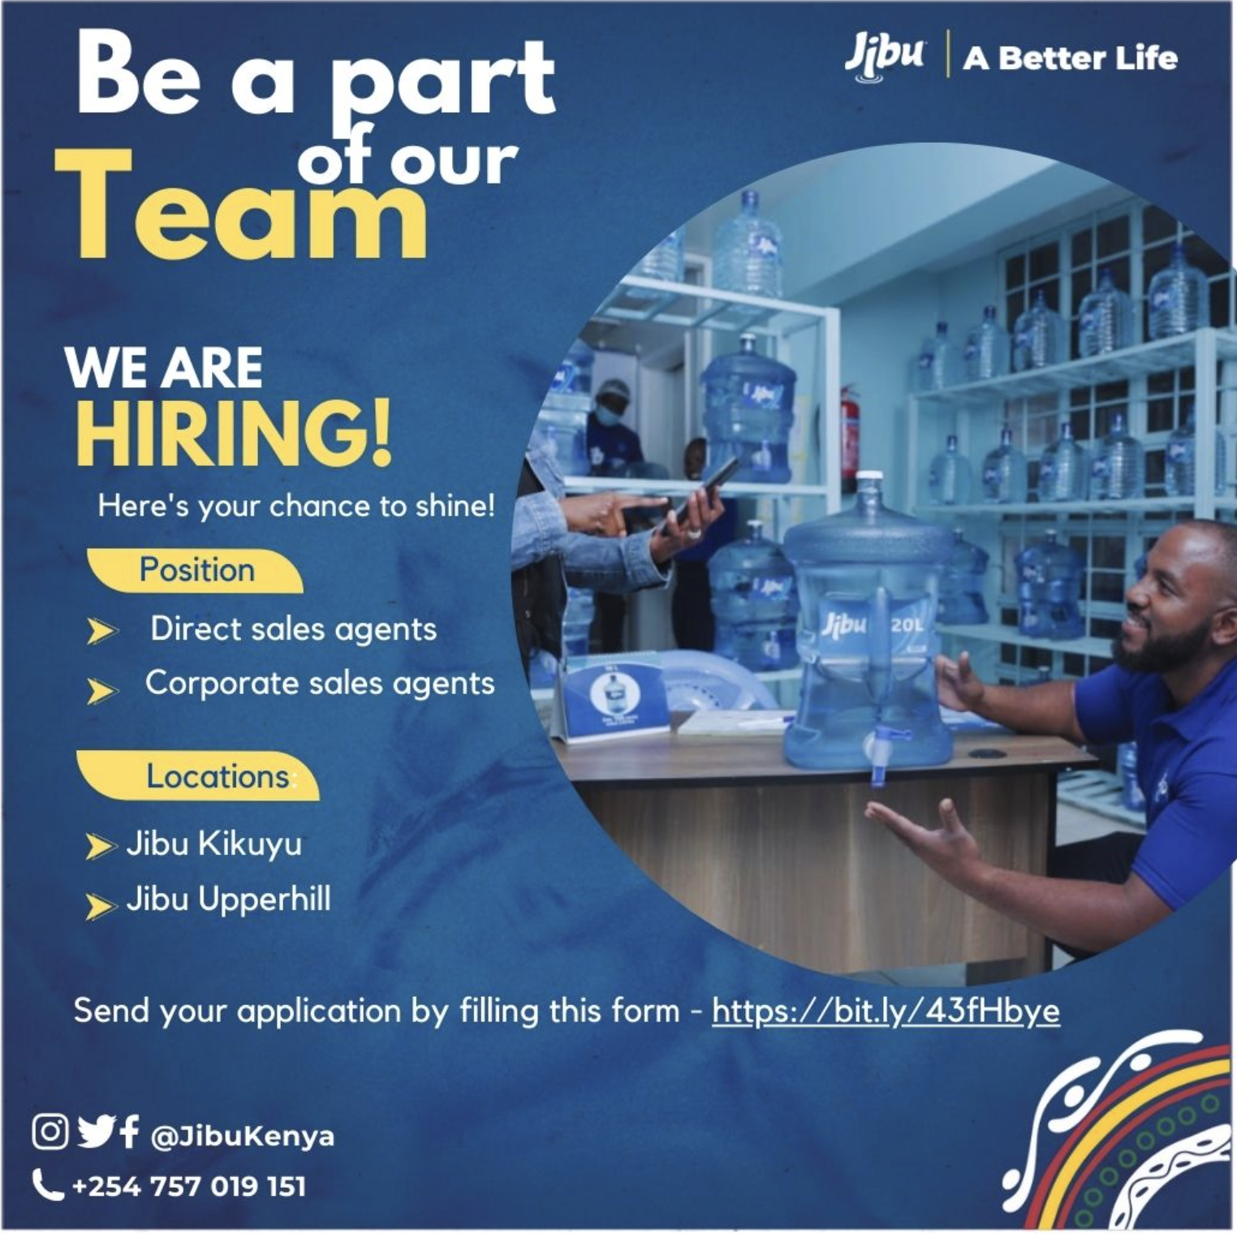
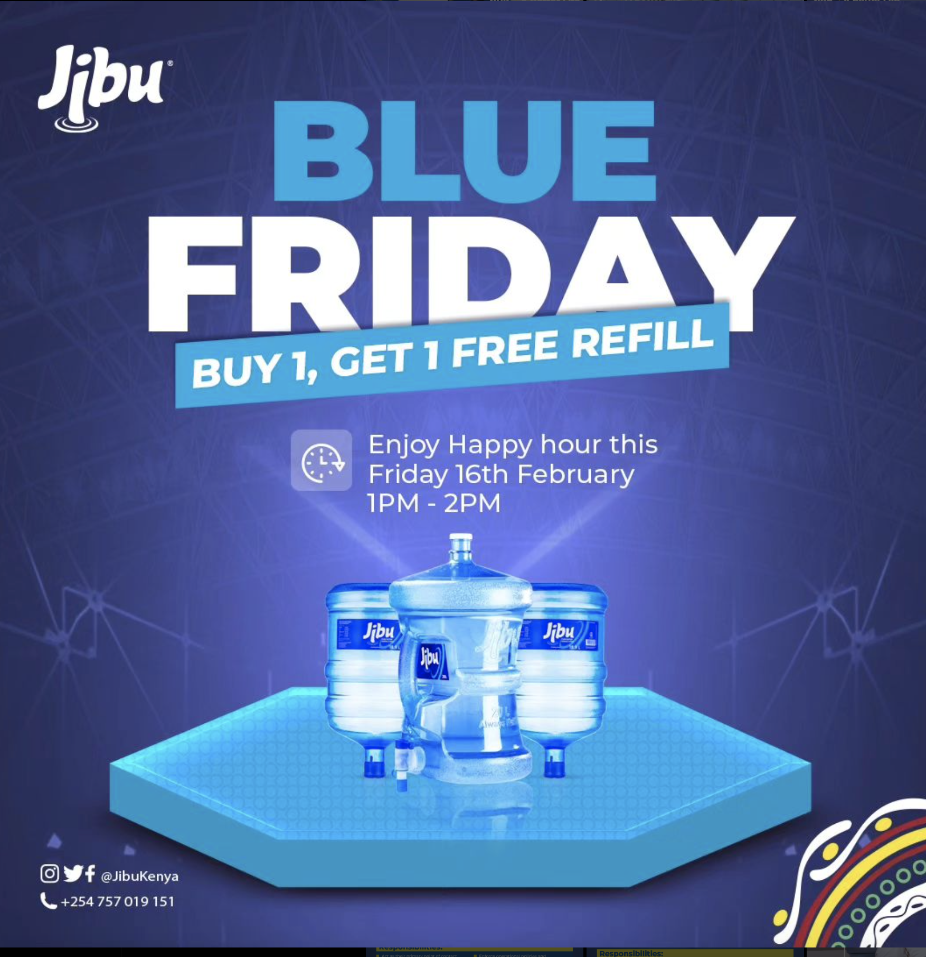

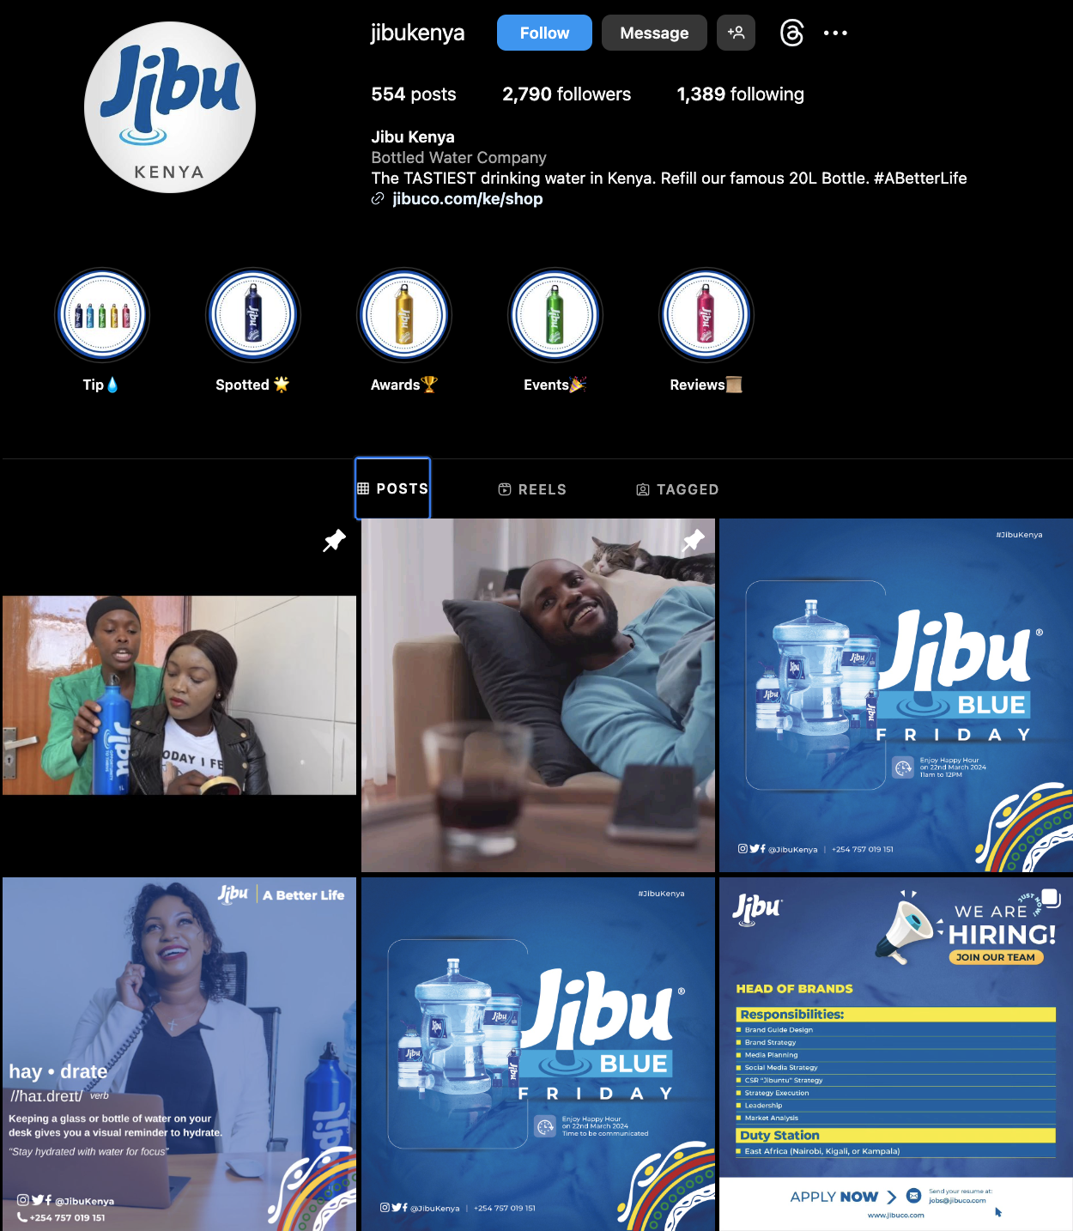
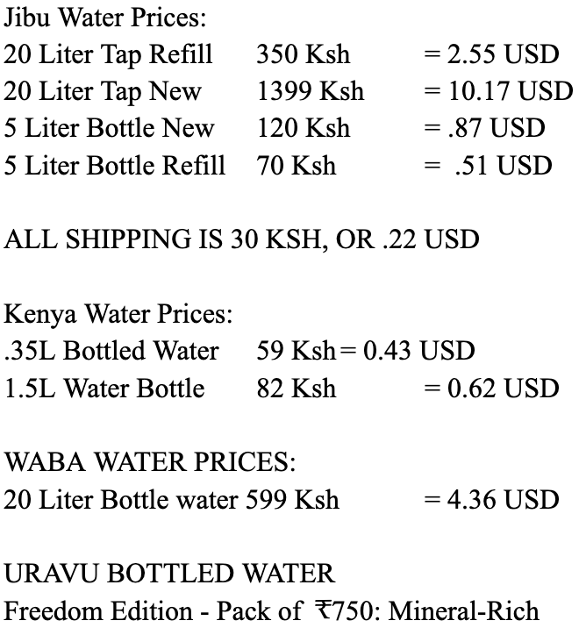
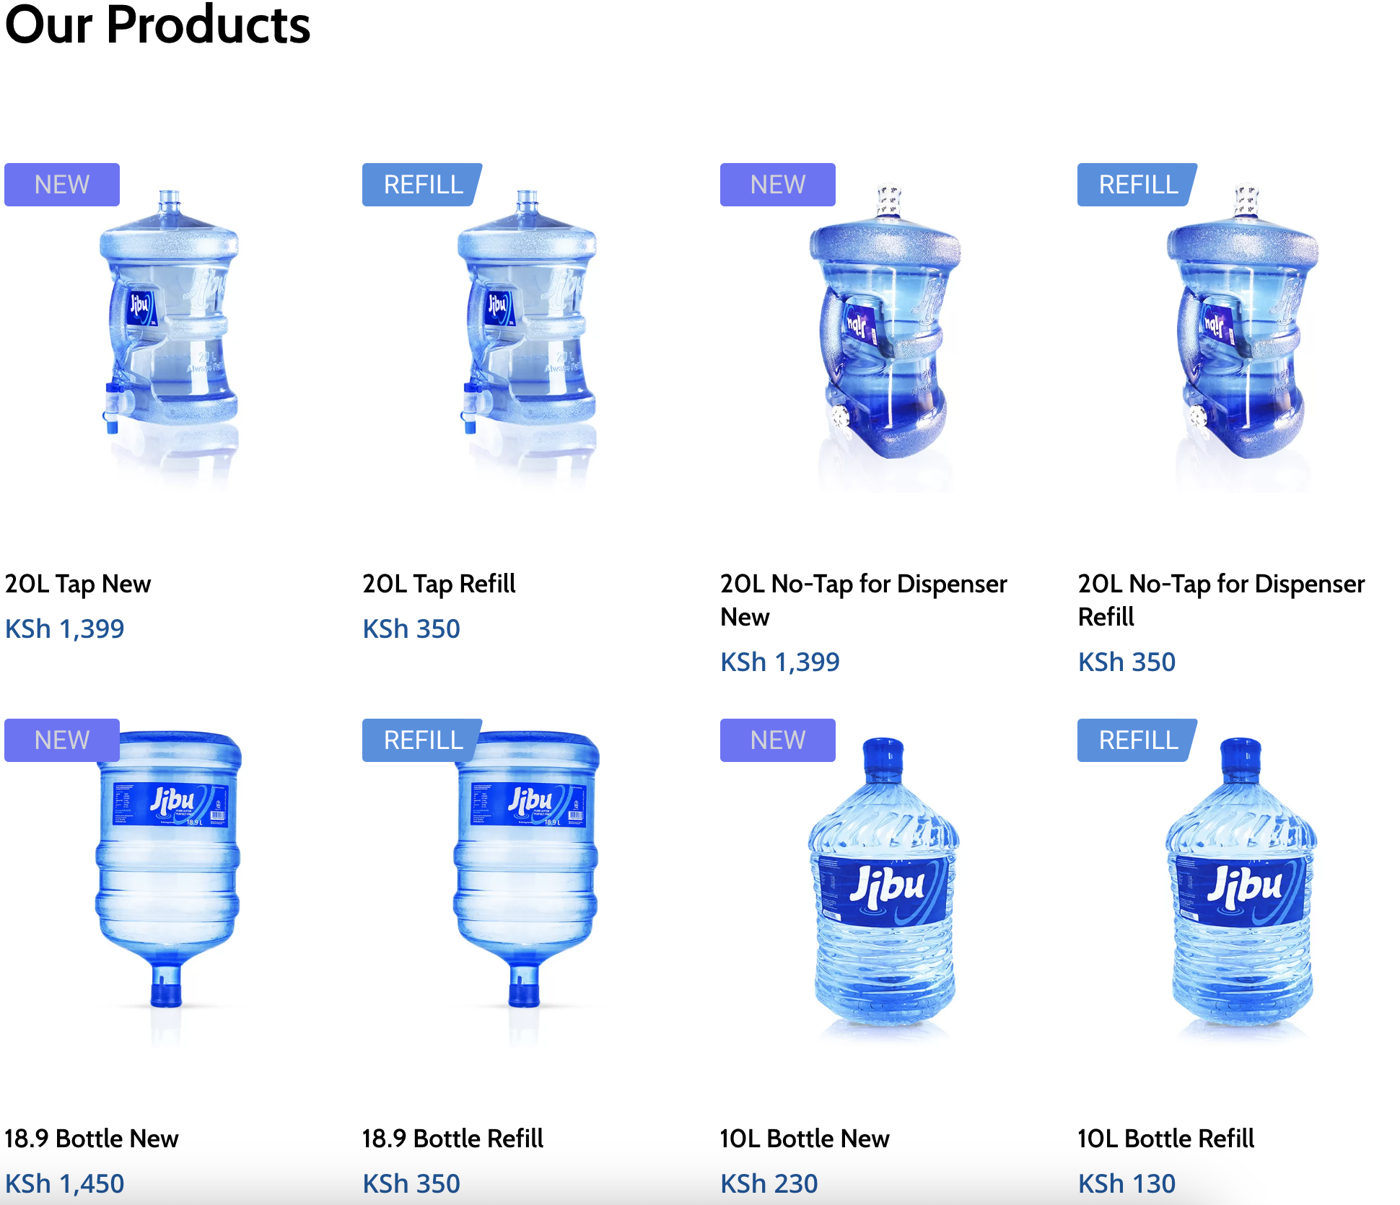
Social Media / Market Analysis
Promotions
Price Leader
Franchising
Easy to reach
Social Media
Quick Delivery

Slide 21
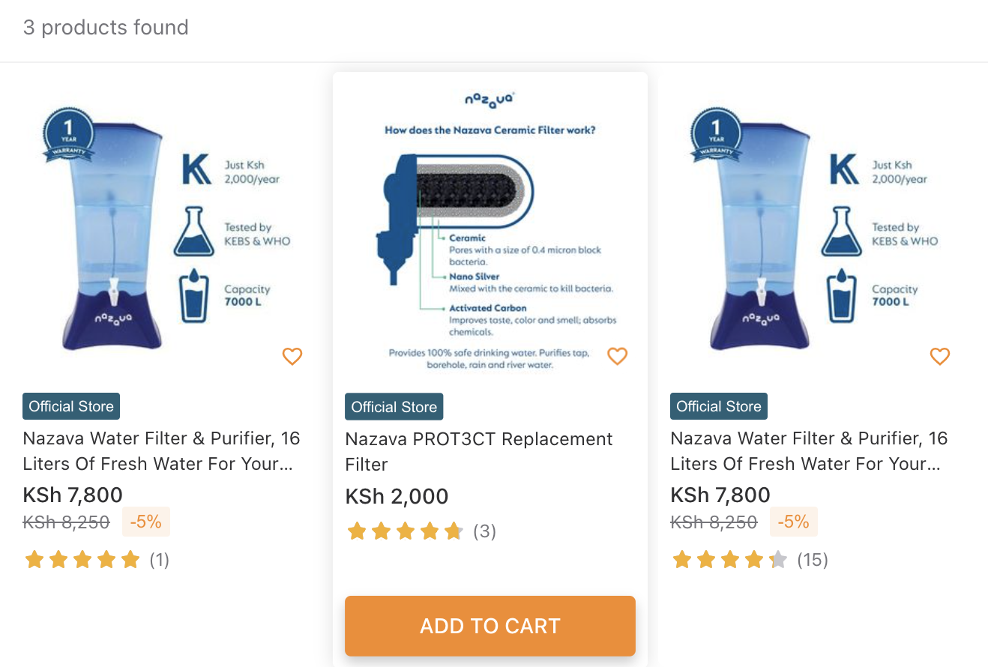
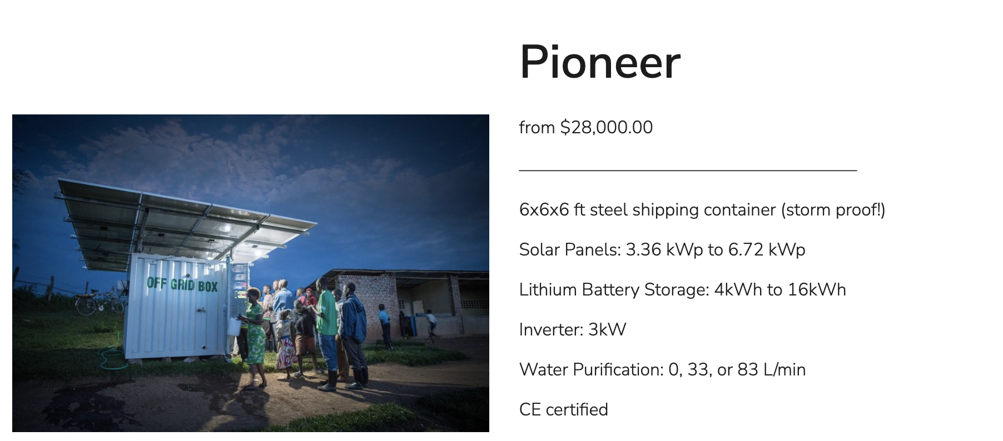
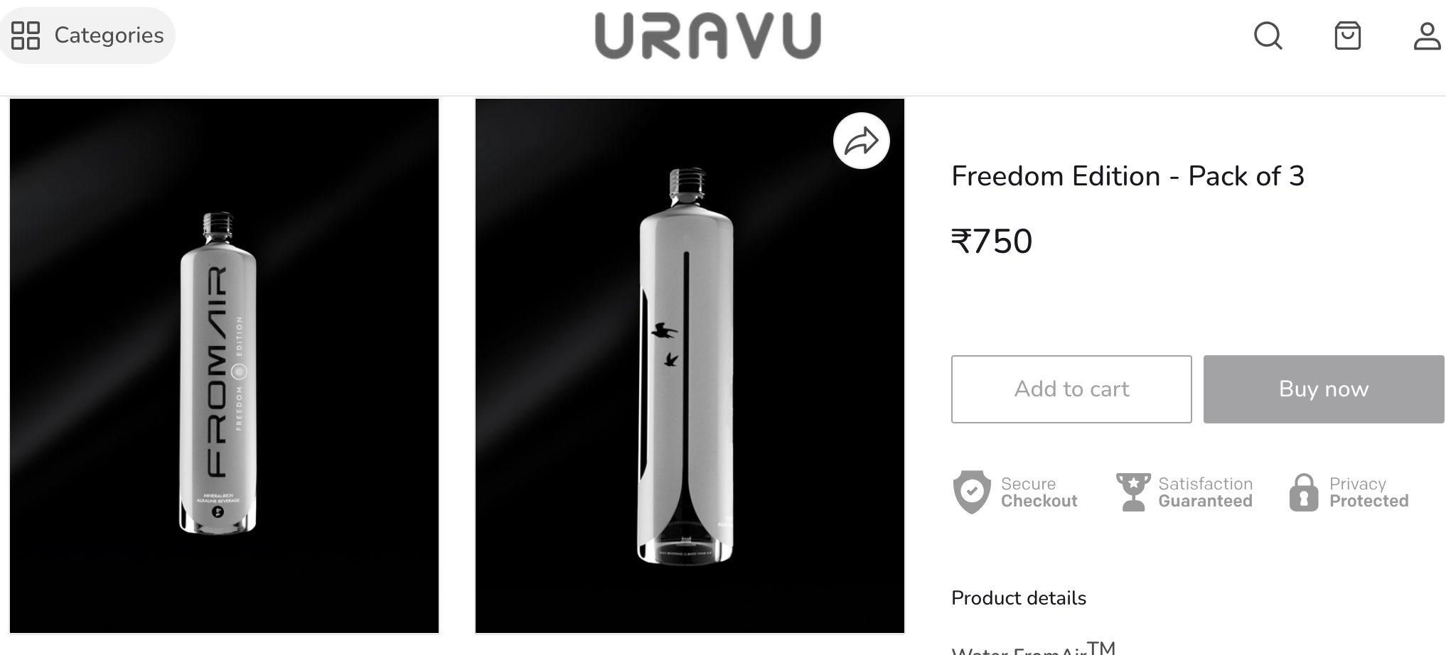
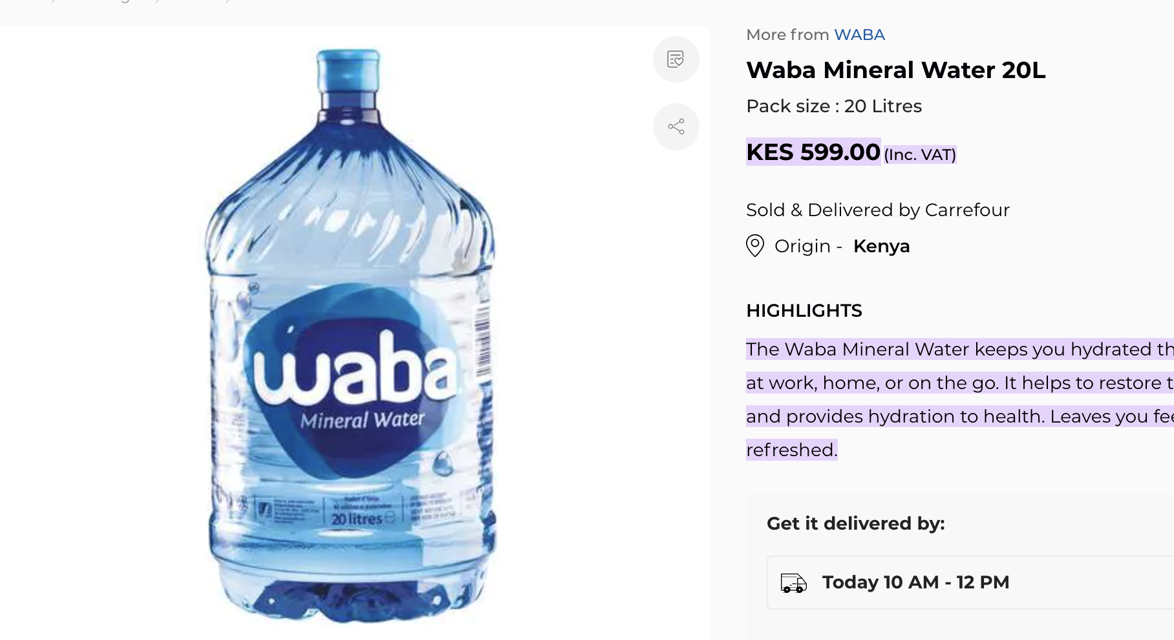
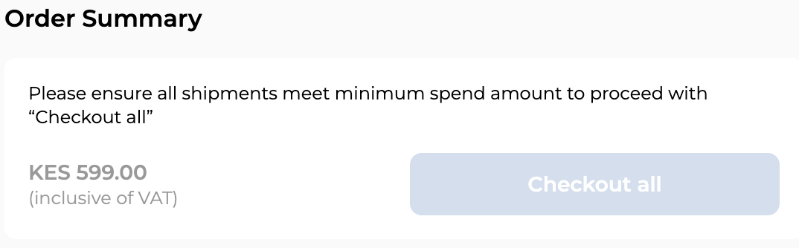
Social Media / Market Analysis

Slide 22
Recommendations
Linear Regression/ CLV:
Focus on marketing / branding to Businesses -> Highest Coefficient for loyal customers and their impact on sales for any category
Step Regression:
For all: Water Quality and Affordability is important for loyalty
Retailers -> Quality of Bottles is NOT important to customer loyalty
Businesses -> Customer Service is important to loyalty, but NOT phone accessibility
Households-> Sponsorships and promotions greatly increase loyalty
Cluster Analysis:
Invest more in marketing (e.g. promotions, sponsorships, branding) for newer franchises in order to gain and maintain more loyal customers

Slide 23
Recommendations
External Market Analysis
Consider partnerships with competitors to further expand outreach
Possibly investigate leasing water purification systems to big businesses, like competitors do
Keep up Promotions/ social media presence. The Kenya marketing team has great interaction with their posts, use as model for other countries.

Slide 24
RecomMendations
Data Collection Changes:
Standardize naming of franchises by code (for example, "drcg002")
Standardize Monthly Upload of Data

Slide 25
Thank you!
Any questions?

